Slide 1
Analysis LN45 with the standard droplet algorithm
-Priyanka Chakraborti

Slide 2
How to generate the rocking curves
Exclude all shots that have an ipm value below 0.1 .These are classified as empty shots. This is different from filtering by ipm bins. That happens in addition to this.
Counting the number of hits at each unique angle
(i) collect all unique angles where scanvar=scanvar-unique.Scanvar is a linear array which is the same size as ipm2.Likewise adu ,xdrop and ydrop enlist the adu-values ,x and y position of the droplet for each run.
(ii) Now apply the IPM filter. Several IPM filters have been applied to the rocking curves to rule out large errorbars or interesting features that might scale by energy.Apply filter to IPM3 after converting bin boundary values from ipm2 to ipm3.
(iii)Collect all ADU rows ,xdrop and ydrop that correspond to the IPM filter range.Notice how all three matrices will have the same dimensions.
(iv) You can either choose to create a dummy matrix of ones of the same dimension as the adu matrix and sum over it or flatten all three matrices mentioned in (iii) post filtering to a linear matrix. Find the length of the flattened matrix after counting up how many fall within shg adu values and that gives you the number of shg counts.Normalize by dividing by the number of unique angles which because of the reason mentioned in (i) is the same as the length of the ipm matrix post filtering.If using the dummy array take sum(sum(M)) since the matrix will be 2d. Normalize the same way. Units will be shg counts/shot@unique angles.
Conts…

Slide 3
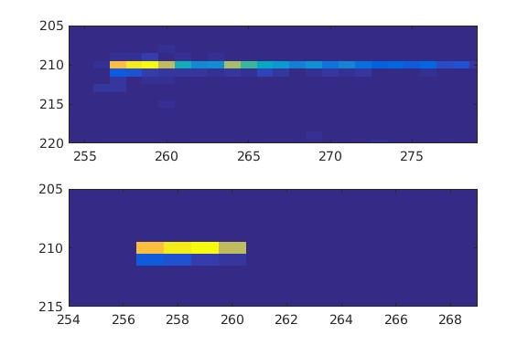
Error bars Three possible sources of error (i) Error from Poisson statistics due to the fixed cross section of the process == sqrt(second harmonic counts) (ii) Error due to pileup. (a) Positive pileup :error due to second harmonic counts ‘piled up’ and diagonosed in the 4w region.We can either count up how many counts fall within the adu range of the 4w single .We wont be able to determine whether these are due to actual 4w(the likelihood is very low for this) or pileup.Either way it goes into the error bar. However if the pileup probability is less than 10% we can use actual Poisson statistic to count up how many falling within the 4w adu range are actual pileup photons. Since it takes 2 -2w photons to make a 4w signal each hit counts as two photons . So at the very end multiply the number of counts by 2. (b) Negative pileup Error due to two fundamental photons coming and hitting a pixel on the detector ,thus being misdiagonosed as an SHG photon . In Bjorn’s slides this is refered to as SHG beam contamination. This is the pileup due to the fundamental hits that fall within the 2w ADU range and hence need to be subtracted from the error bar. (iii) Thus total error=N_{_poisson} + N__{pileupSHG} - N__{pileupfirstHarmonic} + additional counts in the 4w region. How to correctly estimate Pileup (i) Since pileup is pixel based it is not always needed to look at the full droplet but rather at pixels that lie as closest neighbours to the brightest hit in the droplet. E.g. Shown alongside is the hit map for the entire Run of 192. Only a small region was selected which is shown right below it. (ii) Look at the ADU histogram of this region. If we still see enough second harmonic signal and/or fund and/or signal from higher harmonics(which in our case has been 4w).The signal will go down but it will still be confined within the respective ADU regions. We will use this filtered signal to create a binary mask.Sum over this mask and this is the number of pixels we will use for normalizing our counts (iii) Now count up the no of photons that fall within the SHG ADU and Fund ADU region . Use these numbers to estimate fund and second harmonic

Slide 4
Contd.. (iii) The pileup rate=0.5*SHG counts(from (iii))/(total no of shots at this angle post ipm filtering)*(SHG counts from(iii)).Likewise fundamental pileup can be counted up.
(iv) All error bars have to be normalized by dividing by the total no of shots at the unique angle post ipm filtering.
What this looks like when doing it angle by angle.
(i) Each angle will have a different number of shots attributed to it. In addition their hit map wont look the same(True at the peak and right around the peak they look similar). So you CANNOT use ‘the number of pixels for the filtered signal for the whole run’ to normalize the pileup for each individual angle. This will cause over estimation of pileup. This is extremely time consuming since some angles far off Bragg/shg peak will barely show too much signal and we might have to select the whole droplet anyway so in the long run I intend to build a GUI .
(ii) We need to load the hit map for each angle ,generate the ADU histogram for a small region as explained before and estimate pileup from that.
(iii) Finally multiply through by the number of pixels found while doing(ii) above so that the SHG counts and its error bar have the same units.
(iv) Bjorn loads a standard hit map for the ENTIRE RUN,uses the FULL ROI of the droplet and searches for signal for each unique angle and normalizes using these numbers . After working through several run I believe he is basing this off the assumption that most of the hits for each unique angle for a given run will hit the same positions on the detector and the brightest hit will be at the same (x,y) position which is partially true. He says in his slides that the current pileups are probably an over estimation.

Slide 5
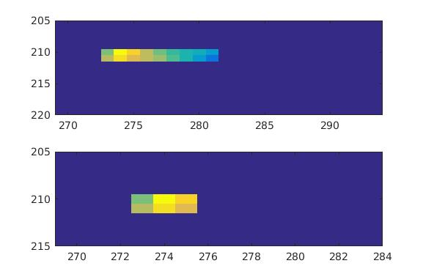
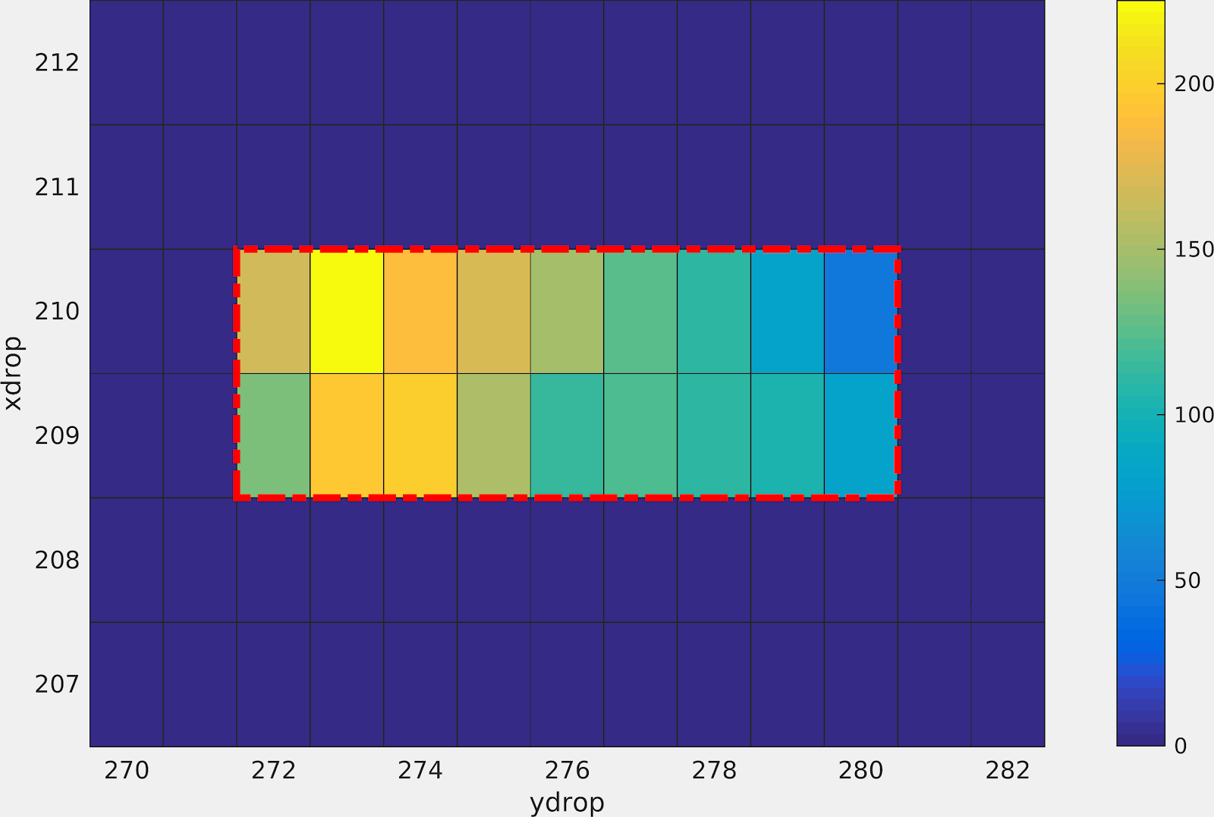
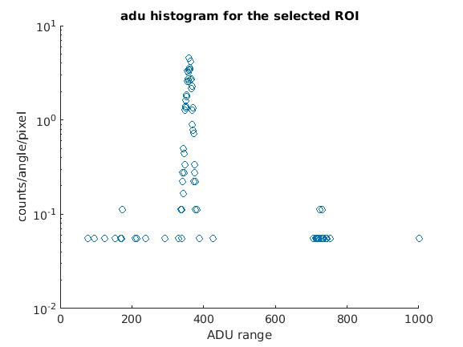
Run 168(220) with only empty shots filtered
As compared to
Note :I am only showing the one at the peak angle . 20 angles total. Don’t have a GUI
so couldn’t save each image. This looks very identical to that for the whole Run.
ADU histogram shows a small amount of signal in
the 6w region. This shows up for Bjorn as well,
But goes away for both of us when filtering by IPM1-2.
This recurs for Run 173 which is why he possibly chose to filter
by that range.

Slide 6
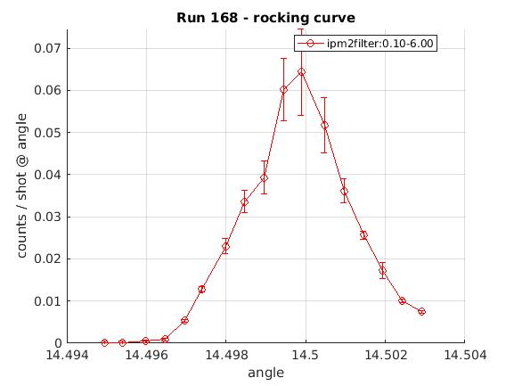
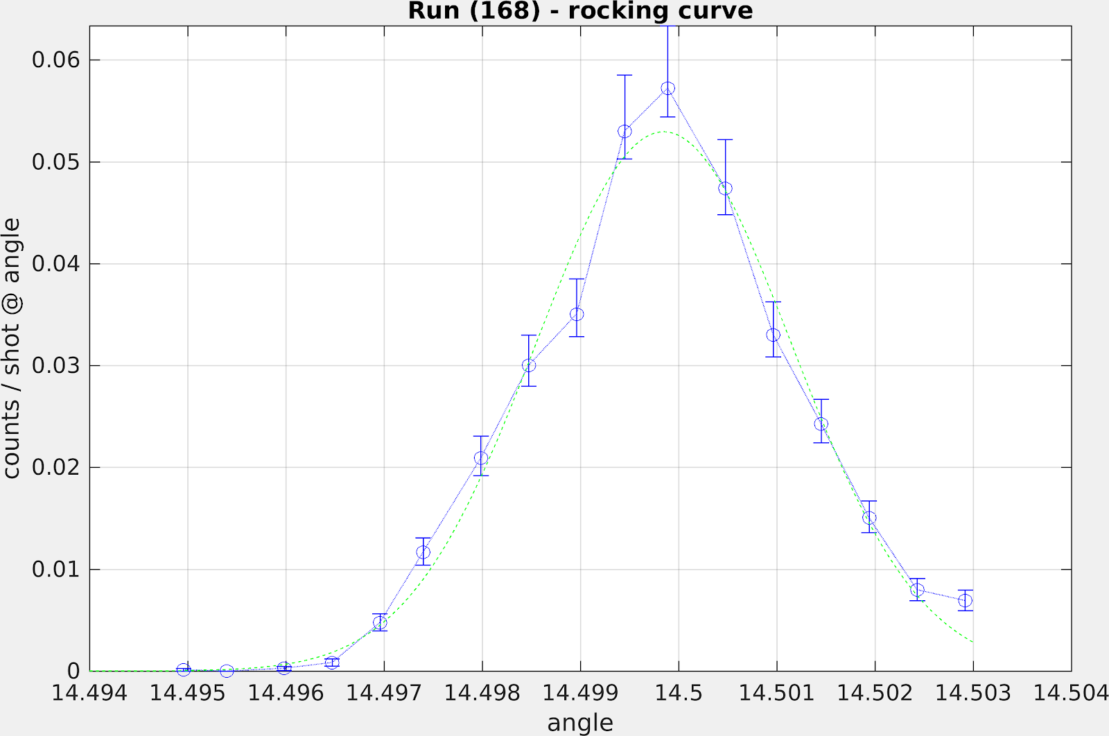
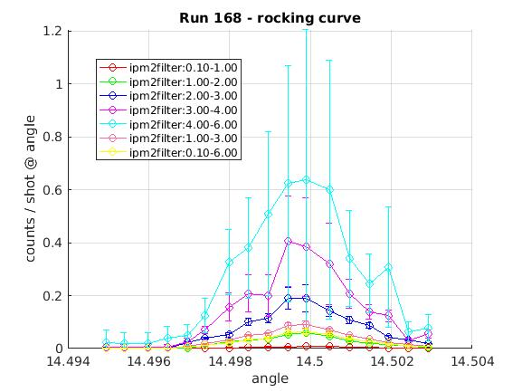
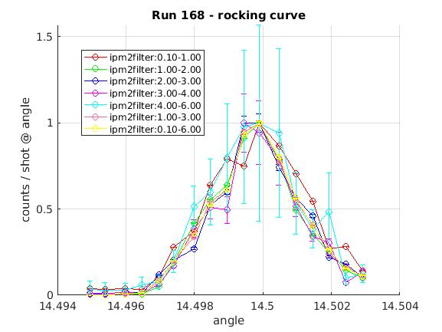
Small difference in my error bars (red) vs his(blue).
Ipm filtering from 1-2 does not have significantly large errors and can be used. No change in shape.

Slide 7
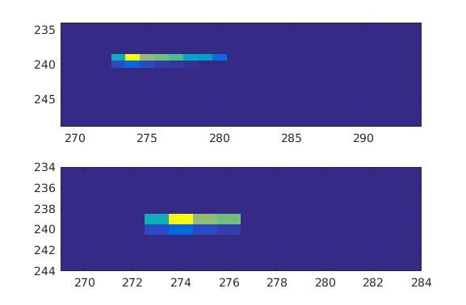
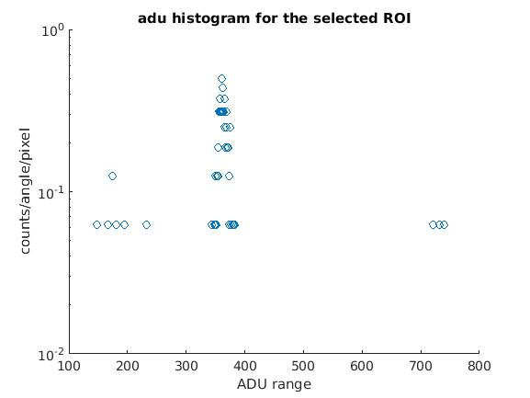
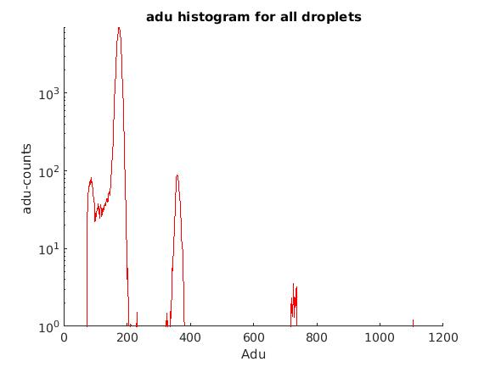
Run 173-[111]
Adu histogram for full run shows a very small signal in the 6w which disappears for the ROI

Slide 8
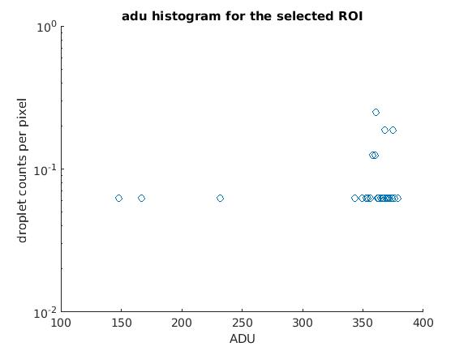
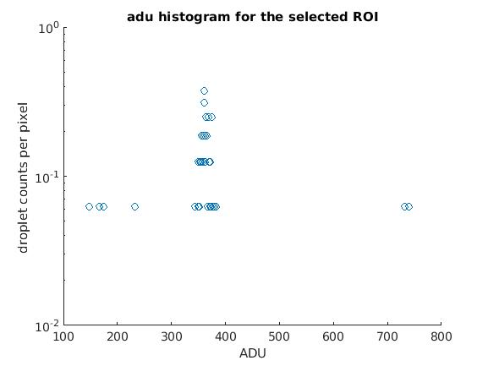
Adu histogram for selected area of the droplet at peak angle after filtering from IPM 1-2 vs the one shown in the previous. No signal seen in the pileup region.
Adu histogram for selected area of the droplet at peak angle after filtering from IPM 1-3. No signal seen in the 6w pileup region. Some pileup shows up in 4w.

Slide 9
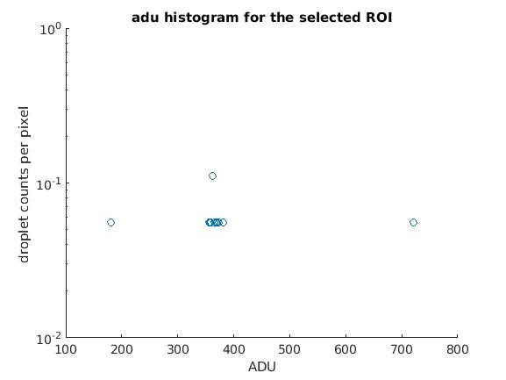
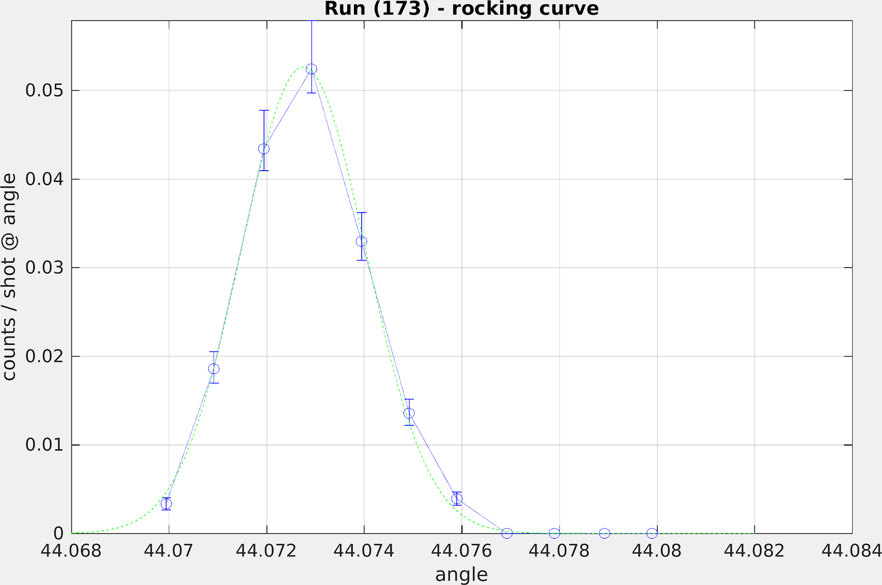
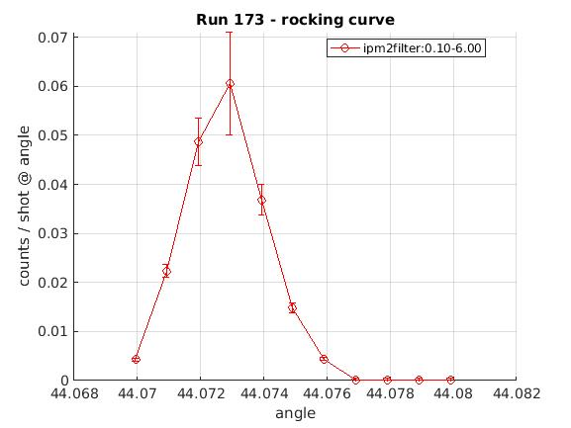
Adu histogram for selected area of the droplet at peak angle after filtering from IPM 3-4 vs the one shown in the previous. Signal in the 6w region reappears . Must be pileup since 3-4 ipm filtering also shows significant error bars on the rocking curve
No ipm filter applied the two rcs are mine in red and Bjoern’s in blue. Mine says 0.1-6.which is pretty much the whole range.My peak error bar looks slightly larger but its vertical extent is roughly the same as Bjoerns .While exporting from his GUI cut off top part of his plot.

Slide 10
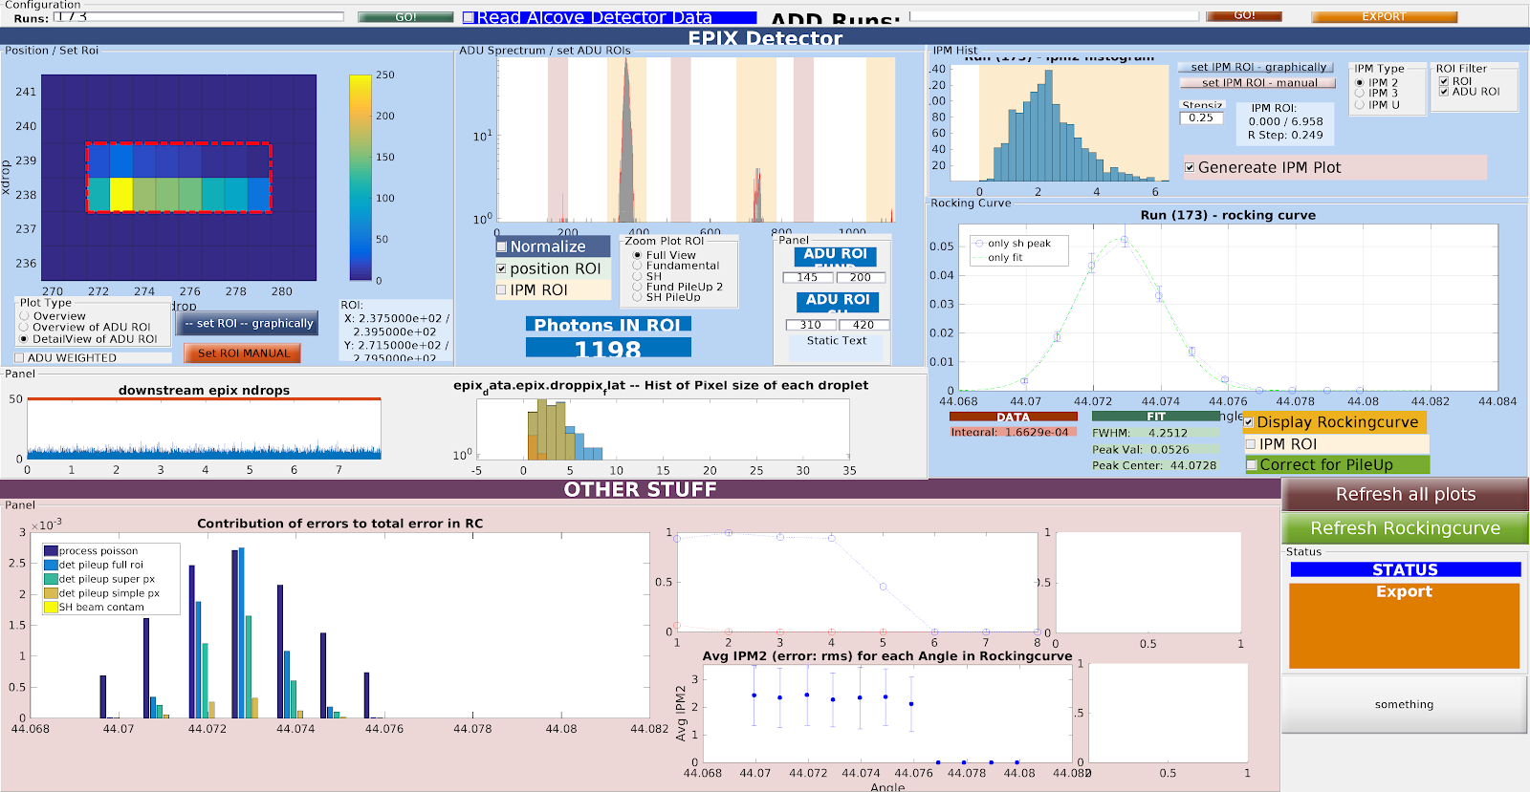
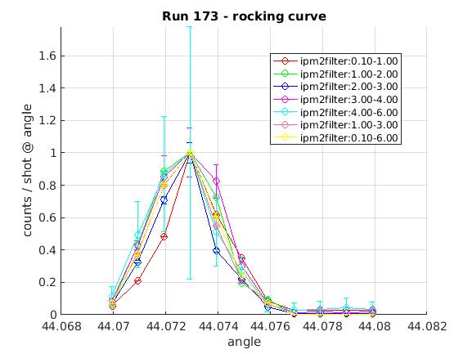
We could choose to filter IPM 1-2 here as well. On the right snapshot from my GUI for run 173 . Here as well he chooses full ROI.

Slide 11
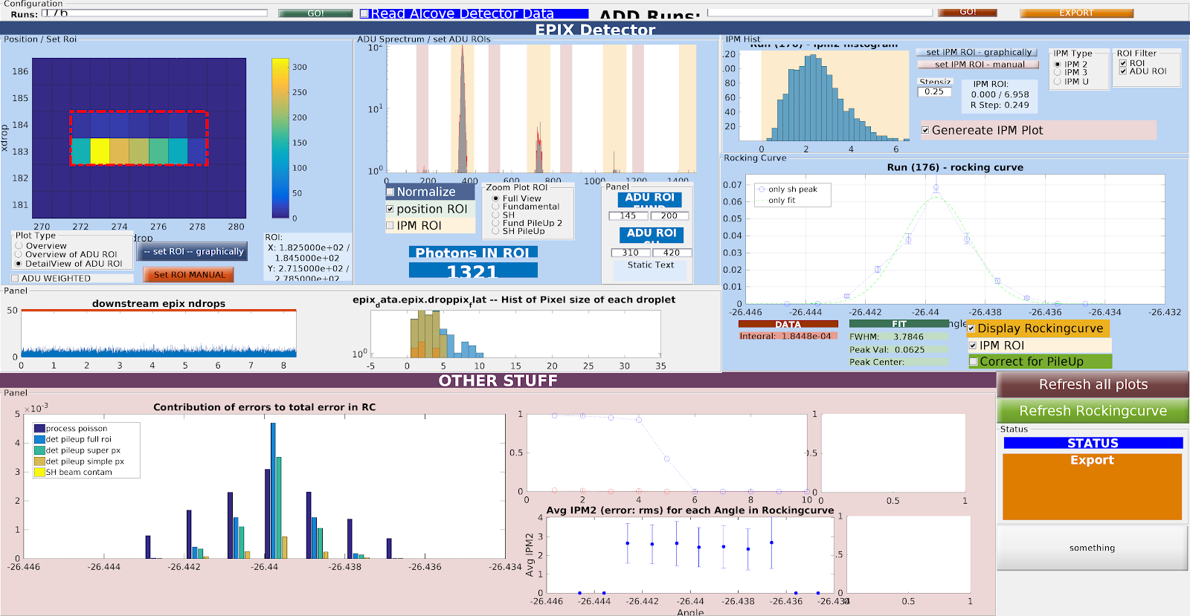
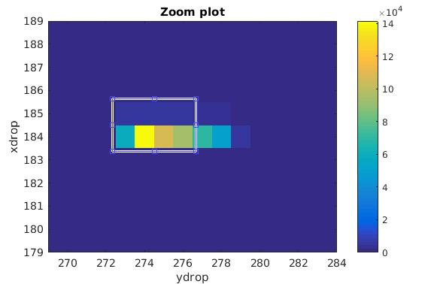
Run 176[11-1]
Roi for mine vs Bjoern’s on the right.
Our color scales differently since he increments by 1 for adu>0 while I increment by the adu value itself.Does not make a difference to the adu hist.

Slide 12
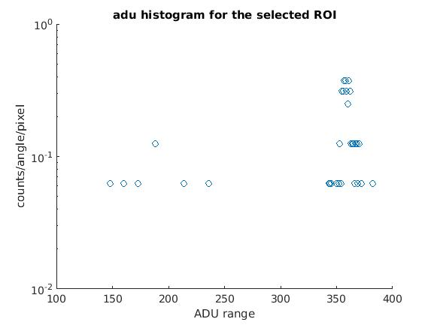
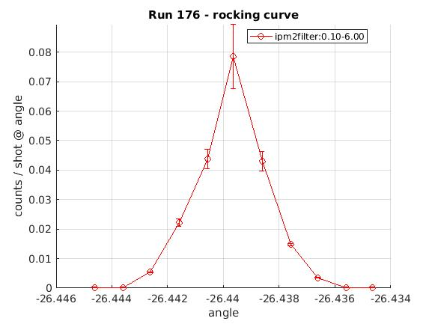
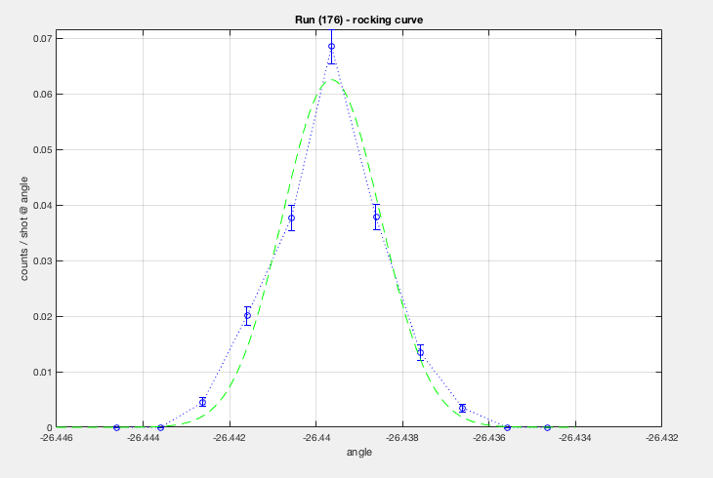
Adu histogram for the roi selected in the last slide for peak angle. No pileup shows up in the 4w or 6w region. This may not need to be filtered . Bjoern’s shows a very small amount of pileup. However he does’nt see it from 1-2 ipm filter. His final rc for the thesis might have used that. Initially our theory and analysis were vastly varying on this plane ,but for the final number he may have chosen ipm 1-2 which brought our answers closer.
Mine in red. Top of GUI RC cut off again.

Slide 13
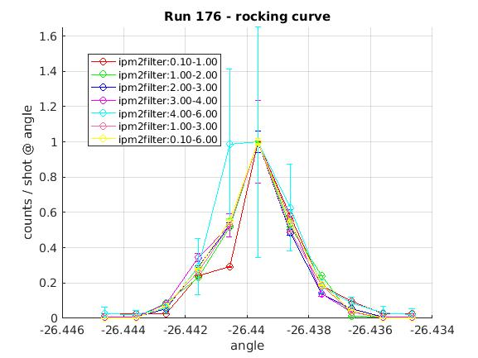
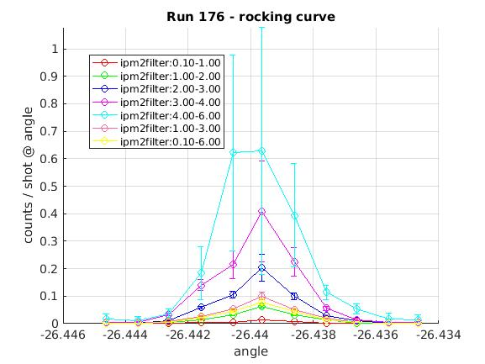
No noticeable change in shape!

Slide 14
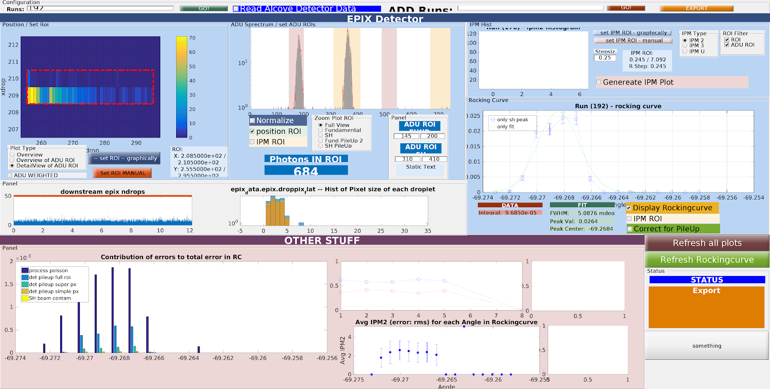
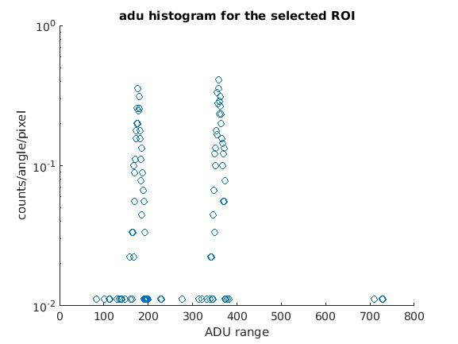
Run 192[00-4]: Chose 192 vs 190 because of better stats.Counts get lower for higher intensities
vs
Does not show any pileup for peak as well
as any other angles in the 4w or 6w region .
Same for Bjoern for whole run~= mine for peak and
angles near peak.

Slide 15
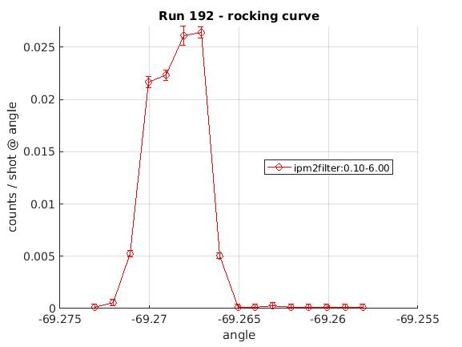
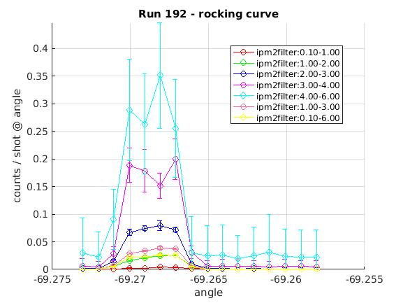
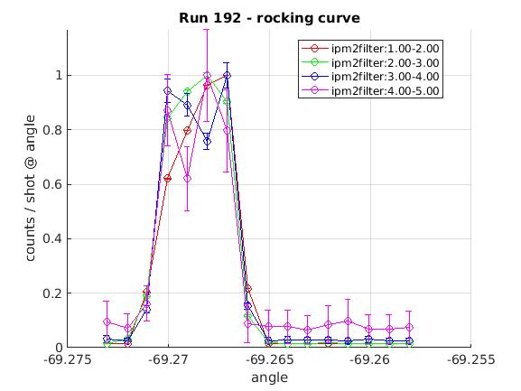
Bjoern’s error bars still a little larger than mine. Could not export GUI RC. Refer to snapshot in the last slide. Error should be primarily due to couting stat.
Plot gets crowded but there is some change in shape with the shoulder becoming more pronounced at higher IPM’s

Slide 16
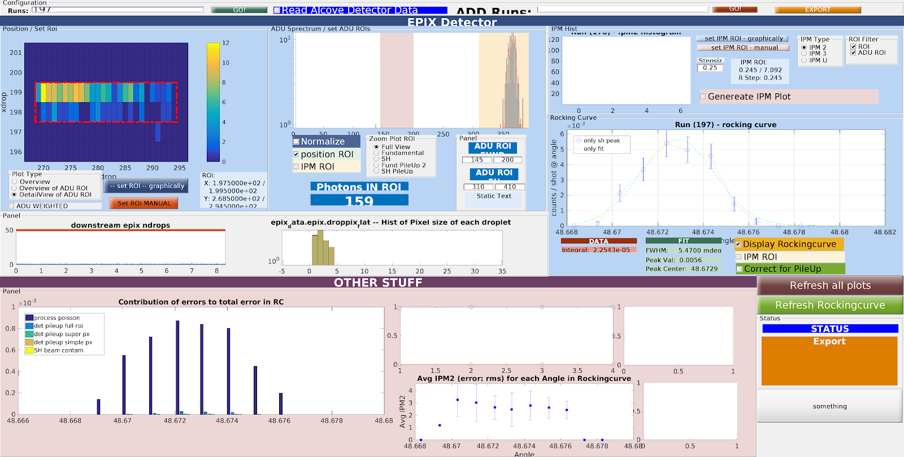
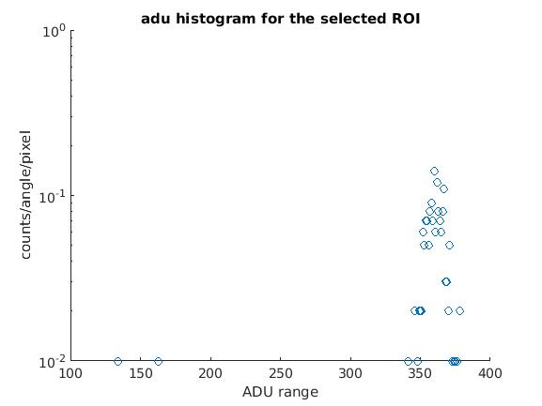
Run 197[660]
Had to choose entire almost entire droplet at peak to see any signal. At lower angles full droplet.
So comparable to Bjoerns for full run at peak angle.

Slide 17
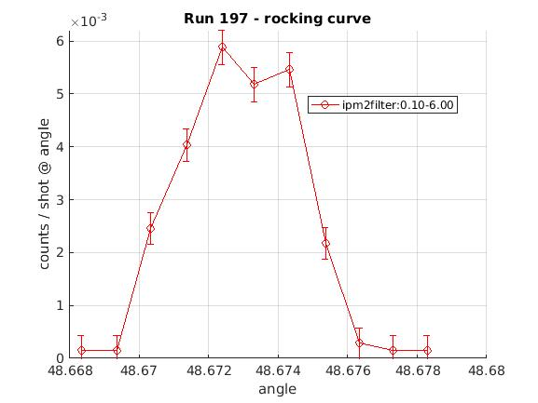
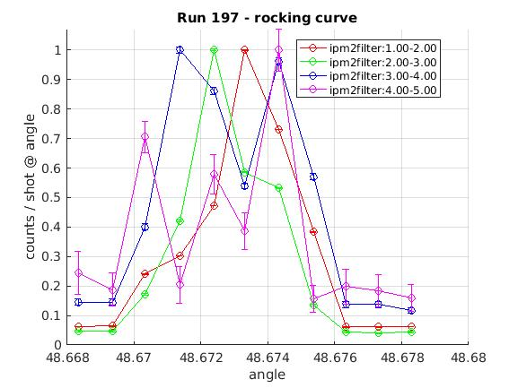
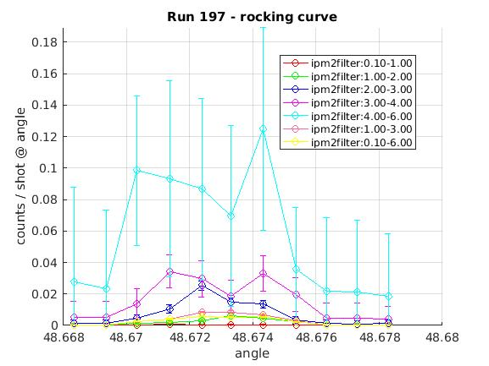
Comparable to Bjoern’s. His error bars are slightly larger still. Probably because of angle to angle estimation vs shot based . See last slide. Its surprising still seeing as his error bar histogram break down shows barely any contribution from anything other than counting stats which is the sqrt of the counts themselves. These get much lower at these intensities anyway.
Plot gets crowded but there might be some change in shape here,seen better in the left plot

Slide 18
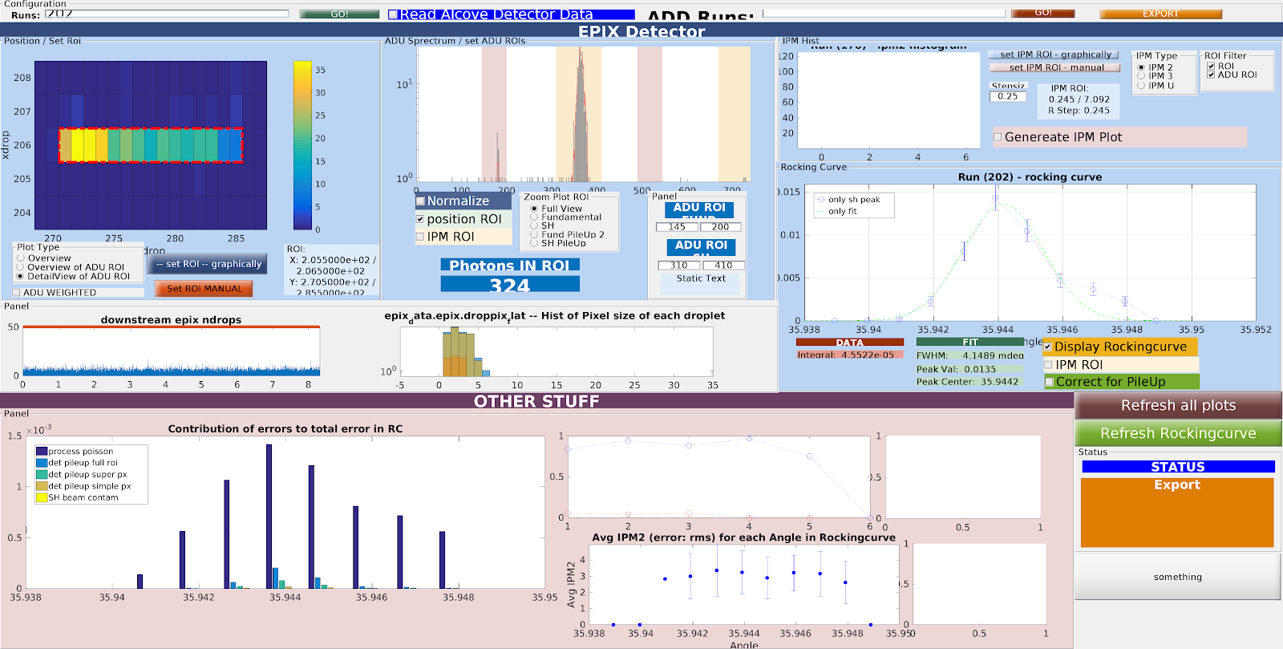
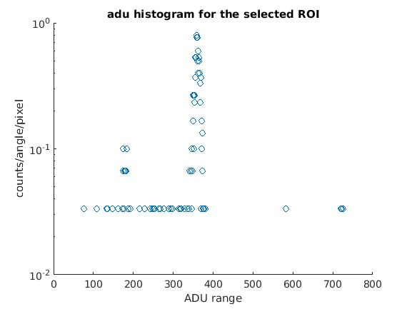
Run 202 [331]
Full roi selection at peak angle
and elsewhere to see good
SH signal
to get any counts

Slide 19
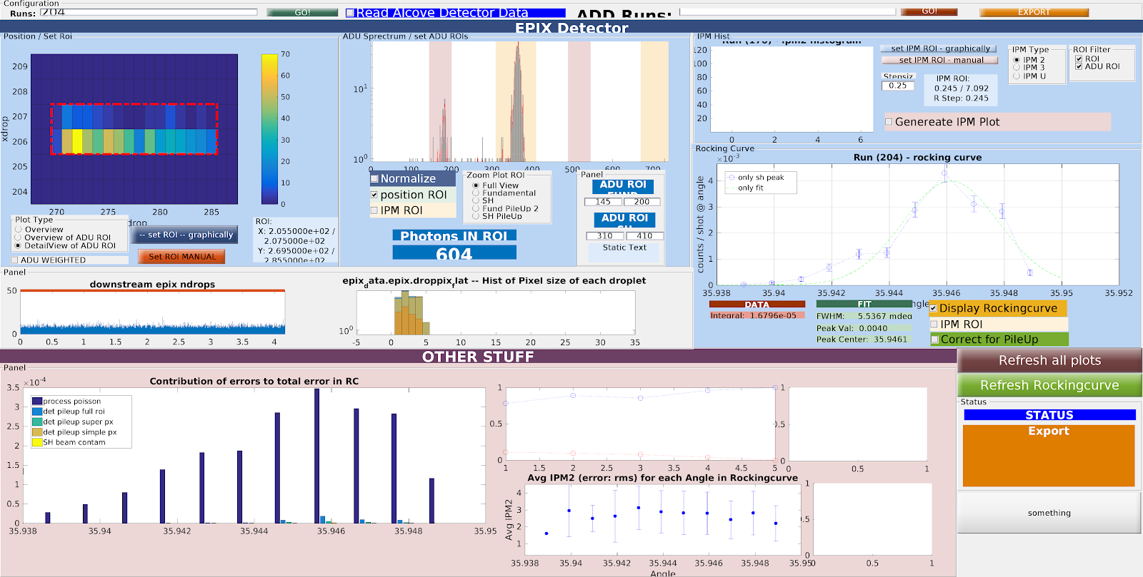
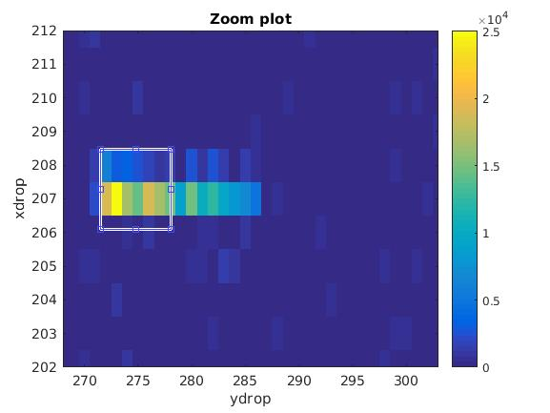
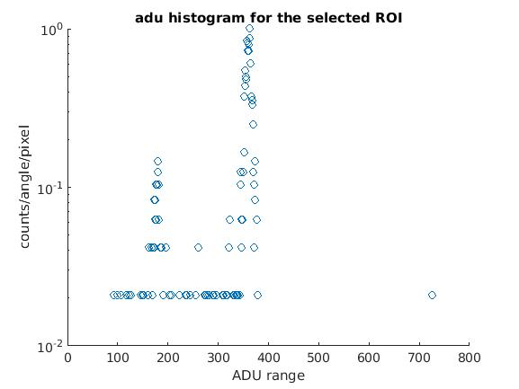
Run 204 [331]
Shows very little pileup for both as compared to error in poisson.

Slide 20
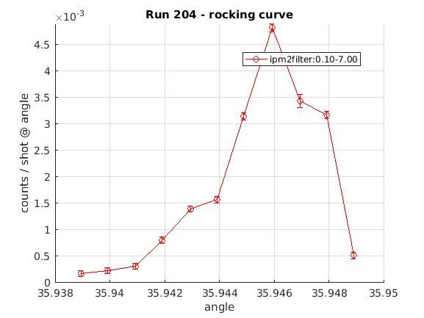
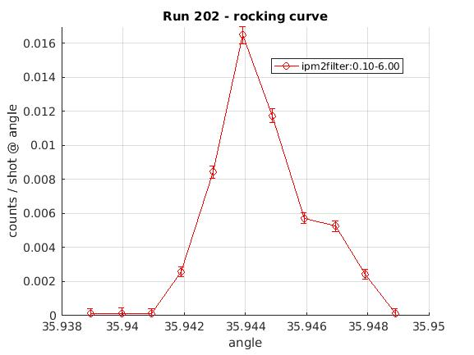
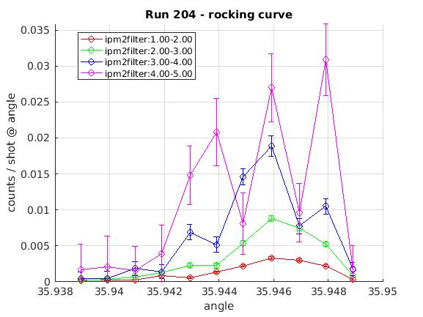
Bjoern’s error bars are still larger for both runs !
There might be some change in shape here as well!Better seen
In Run 200 with 113

Slide 21
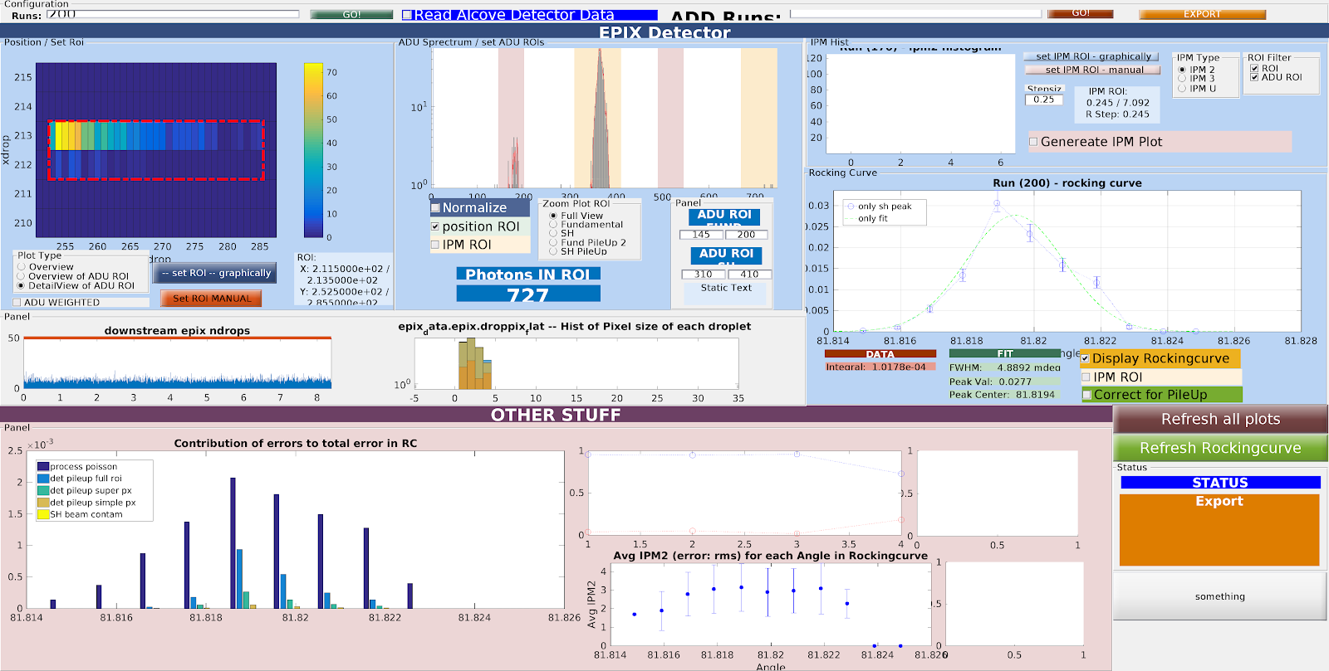
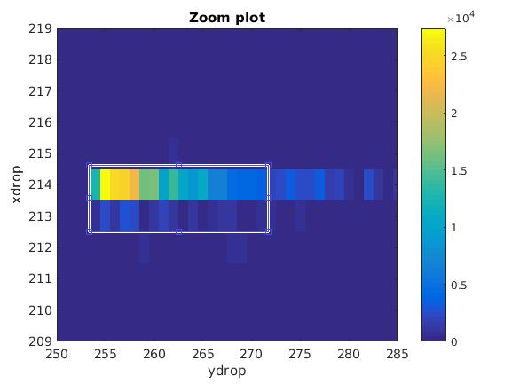
Run 200[113]
Was able to get signal with
Smaller Roi

Slide 22
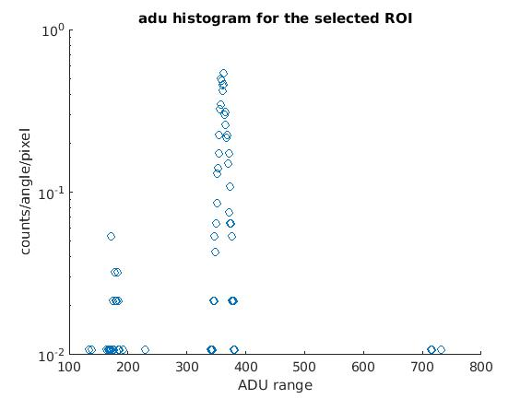
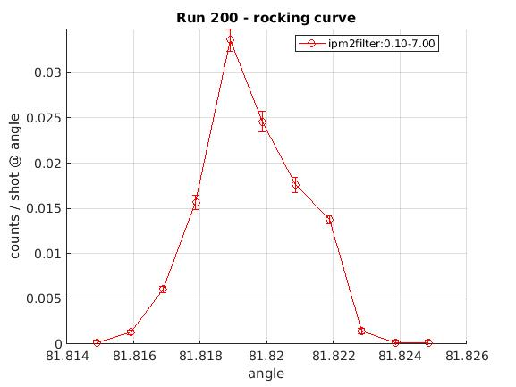
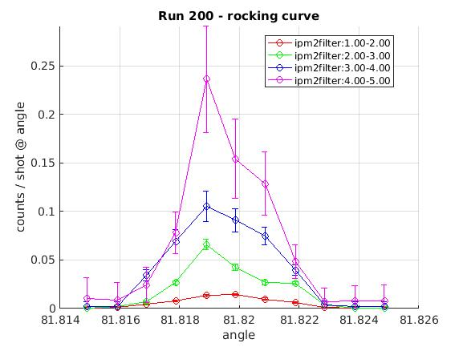
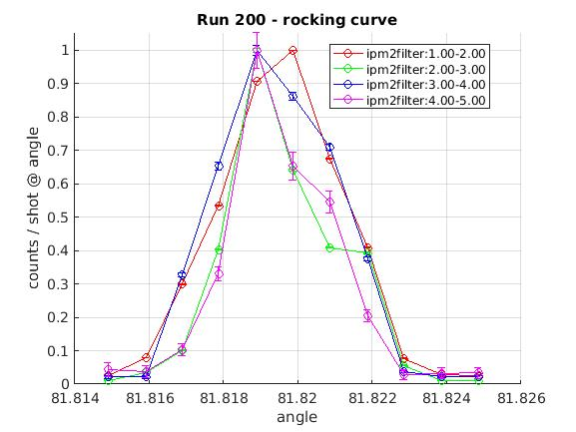
Change in shoulder seen more prominently here

Slide 23
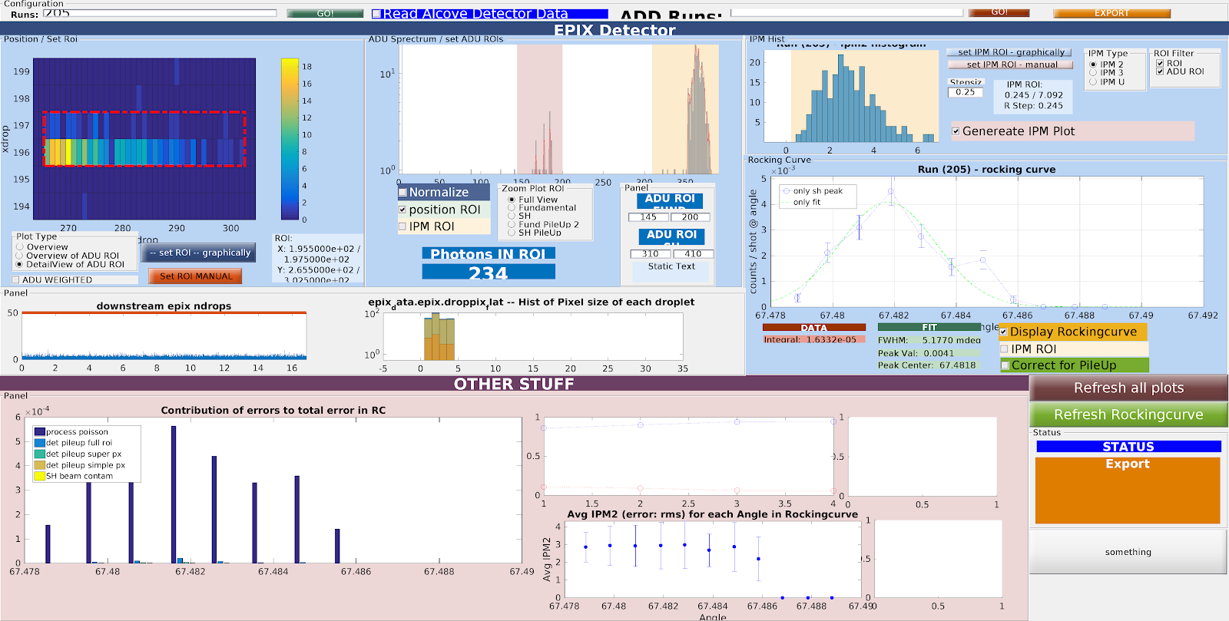


Run 205[771]

Slide 24


Incomplete!
All rocking curves have minor changes in errorbar. Will be updated!
Everything else stays the same

Slide 25
IPM vs hist counts
Procedure:(a) Same as the one used for the RCS.Load hit mao of Run for each ipm bin.
(b)Select ROI . Look at signal.Normalize by pixel.
( c) For these high stat Runs highest intensity on the droplet and the surrounding pixels did not shift significantly ,roughly 1-2 pixel shift seen at very low energies.ROI roughly stays the same.
(d) Several of the intensities show higher pileup signal which do not go away even when screening by IPM bin.These have been included in the error bar on top of poisson stat and counts towards positive error . Negative error comes from SHG beam contamination from fund 2w.
(e) Bar graph DOES NOT INCLUDE –ve error from fund2w pileup.
(f) NOT all the curves have fully quadratic fits. [331],[113],[00-4] and [111] have nonzero linear coeff going from 0.1-3. Exact coeffs will be tabulated later.

Slide 26

Run 169-[220]
1.Droplet looks very similar going from one bin to another.Selected a small region around the brightest pixel of roughly 6 pixels length.
2. No shift in peak pixel.This is the ADU histogram at ipm bin 1-2. The others closely follow. All of them show signal in the 4w range and 6w range. Histogram for the whole run has signal in 8w range as well.
3. Bjoern includes fundamental 2w signal within positive error bar.I included it as a negative vertical error.

Slide 27


Run 169 contd
Histogram of Ipm2 VS counts/shot.Shows good agreement with Bjoern’s figure.Fits are slightly different from his owing to his unequal binsizes.
Breakdown of error contribution.
This run showed an over all large pileup.

Slide 28

Run 174[111]
Droplet remains unchanged from bin to bin. However needed FULL ROI to see signal.

Slide 29



Slide 30

RUN 177[11-1]
Droplet changes very slightly at in going from IPM 2-3 to higher IPM. 2 pixel shift on the brightest spot. Selected a 7 pixel long region.Signal stays the same.

Slide 31



Slide 32


RUN 201-[113]
Same comments as 11-1

Slide 33

[00-4] Needed to select Full Roi to see signal.

Slide 34


Bjoern’s positive vertical errors are longer than mine. However Bjorn counts fund pileup within positive error bar. Ipm range 5-6 shows very large poisson errors. Hence ignored the bad fitting .

Slide 35


[331]
Full roi selection was needed . ADU hist showed no pileup.

Slide 37


[660]
needed a 10 pixel long region to see signal. No pileup. Not a good fit at high ipms but since the main contribution to error is poisson statistics from IPM4 and above ignored the bad fitting.

Slide 38
[771]
They did not perform a long run for this intensity . Bjoern artificially used the RC data to construct the IPM vs counts to compare custom vs Silke’s algorithm

Slide 39
Comparison of FWHM’S to Darwin curves from online database. (Red indicates the run that was used for having better statistic)
Run | Plane | FWHM(fundamental) in mdegs | FWHM(experiment) in mdegs**** | FWHM-second harmonic (online Darwin) in mdegs
168 | [220] | 0.36t/4.85 | 2.85 | 0.3
173 | [111] | 0.9t/T4.726 | 2.5 | 0.57
176 | [11-1] | N/A | 2.09 | 0.57
190,192 | [00-4] | N/A | 4 | 0.16
195,197 | [660] | N/A | 4.18 | 1.1e-2
200(No Signal) | [113] | N/A | 1.67 | 0.16
202,204 | [331] | N/A | 3 | 8.7e-2
205 | [771] | N/A | 4.13 | 3.3e-2

Slide 40
Experimentally observed FWHMs show discrepancies. Computational limitations on calculating the rc’s from the
simulation.May not necessarily give better results although gives very reasonable results
with predicting outgoing SH photon number at peak.
We will investigate this further. PRL 2014 has a similar observation on FWHM’s for
the [220] plane and attributes it largely to the spiky nature of the FEL which may
not be the case here.
Ennumerate possible causes:
Imperfections in the crystal itself.
Jitter in the pulse and imperfect profile.
Inability to correctly get the time duration of the pulse,pulse energy etc..
Failure in the basic tenet of the model-assuming a free electron plasma like non-linearity.

Slide 41



Widths of signal on epix( Conversion factor 1px=50µm). Recall detector reads horizontal as y.
Width ~ 9px = 450µm
Width ~ 8px = 400µm
Width ~ 8px = 400µm

Slide 42



Width ~ 30px = 1500µm
Width ~ 26px = 1300µm
Width ~ 24px = 1200µm

Slide 43



Width ~ 16px = 800µm
Width 0.8mm
Width ~ 37px = 1850µm
4mm
4mm
detector
Note:Bragg angle not always same as theta_SH.Log bk(as well as simulation)
measures all angles wrt 220 plane which is shown in fig.
0.8mm

Slide 44





Run | Plane | Angle between plane and 220 | Angle between pump pulse and 220 | Detector angle | Length of Signal (µm) On Epix detector(refer to prev.slides) | prop_thickness. (???) |  |  | Bragg angle
168 | 220 | 0 | 14.5 | 28.9979 | 450 | 800 | 1.03 | 824 | 14.5
173 | 111 | 35.26 | 44.07 | 17.6379 | 400 | 800 | 1.39 | 1112 | 8.81
176 | 11-1 | -35.26 | -26.44 | 17.6379 | 350 | 800 | 1.12 | 896 | 8.82
190,192 | 00-4 | -90 | -69.27 | 41.4709 | 1500 | 757 | 2.83 | 2142 | 20.73
195,197 | 660 | 0 | 48.67 | 97.366 | 1300 | 800 | 1.51 | 1208 | 48.67
200 | 113 | 64.76 | 81.82 | 34.1439 | 1200 | 287 | 7.02 | 2018 | 17.06
202,204 | 331 | 13.26 | 35.94 | 45.3899 | 800 | 800 | 1.24 | 992 | 22.68
205 | 771 | 5.77 | 67.48 | 123.456 | 1850 | 800 | 2.61 | 2088 | 61.71
All angles ~c.a agree with theoretical simulation.Not sure how prop_thickness was measured during exp .

Slide 45

Snippet from the code
% Everything on the RHS except the pump's Ep^2 which is a matrix grid:
% Driving amplitudes for the currents%%
%XiG= -1*(1/(2*nSH))*sqrt(mu0/e0)*(-1i)*e0 * (wSH) * ( ((re*(((2*pi)/(kSH))^2)*den*RoG)/(pi))*cos(2*thetaBragg) ); % linear (G component) susceptibility
J_NL = 1*(1/(2*nSH))*sqrt(mu0/e0) * (((q^3)*structureFactor*RoG*den)/(4*(m^2)*(wlaser^3))) ...
* ( kPump*cos(abs(thetap) + abs(thetaSH) + (pi/2)) + 2*G*cos(abs(thetap)-abs(thetaG))*cos(abs(thetap)+abs(thetaSH)) )
J_NL1 = 1*(1/(2*nSH))*sqrt(mu0/e0) * (((q^3)*structureFactor*RoG*den)/(4*(m^2)*(wlaser^3))) ...
* ( kPump*cos(abs(thetap) + abs(thetaSH) + (pi/2)))
J_NL2 = 1*(1/(2*nSH))*sqrt(mu0/e0) * (((q^3)*structureFactor*RoG*den)/(4*(m^2)*(wlaser^3))) ...
* ( 2*G*cos(abs(thetap)-abs(thetaG))*cos(abs(thetap)+abs(thetaSH)) )

Slide 46
Run | Plane | Exp(2w count) | Simuln.(2w count) | IC(exp Fund) normalized in mdegs | J_scat | IC(exp-SH)(normalized) in mdegs | IC(theoretical SH) in mdegs | J_NL1 | J_NL2 | Pulse energy(microJ)
168 | 220 | 1.75 | 1.78 | 4.5/0.4t | 1.4e-13 | 3 | 0.38 | 5.88e-13 | 2.03e-12 | 72
173 | 111 | 1.81 | 2.2 | 6.75/1.2 | 7e-13 | 2.817 | 0.69 | 2e-12 | 1.35e-12 | 71.2
205 | 771 | 0.09 | 0.11 |  | 8e-15 | 3.87 | 4e-2 | 5.89e-13 | 1.75e-13 | 72
176 | 11-1 | 1.78 | 2.023 |  | 2e-14 | 2.546 | 0.69 | 1.8e-12 | 1.6e-13 | 72.4
190 | 00-4 | 0.72 |  |  |  |  |  |  |  | 71.2
192 | 00-4 | 0.67 | 1.02 |  | 1.55e-15 | 4.207 | 0.2 | 6.5e-12 | 1.9e-13 | 71.2
195 | 660 | 0.16 |  |  |  |  |  | 5.7e-13 | 3e-12 | 72
197 | 660 | 0.22 | 0.187 |  | 6.5e-15 | 3.3 | 1.4 e-2 |  |  | 72
200 | 113 | 0.60 | 0.81 |  | 1.9e-15 | 3.6 | 0.2 | 5.6 e-13 | 1.1e-12 | 71.5
202 | 331 | 0.23 |  |  |  |  |  |  |  | 71.8
204 | 331 | 0.07 | 0.12 |  | 3e-15 | 3.82 | 0.1 | 4e-13 | 1.33e-12 | 72
Ic=area under curve.

Slide 47




[220]
No errorbars
have been added to
Fund r.c since we are
only comparing shapes
[111]

Slide 48




[11-1]
[00-4]

Slide 49




00-4
660

Slide 50




331
113

Slide 51




331
771

Slide 52
Grid sizes chosen along three dimensions :Taken from the simulation code
z0=L/(2*cos(thetap)); % length for z integratin
% grid for step size integrations in fourier space%%
az=(sin(thetap)*2*w0x + cos(thetap)*2*vgPump*tau);
ax=(cos(thetap)*2*w0x + sin(thetap)*2*vgPump*tau);
at=(az)/(vgPump*cos(thetap));
[thetaSH ,dKxNL ,dKzNL]=SH_rockingCurvePM(pphotonenergy,Z,element,den,G,thetap,thetaG); % PM and mismatch for the nonlinear process
[thetaScat, dKxBragg, dKzBragg]=braggPMmod(kBragg,kSH,G,thetaSH,thetaG); % PM and mismatch for the Bragg scattered SH
dx=(min([ax 1/(abs(dKxNL)+0.01) vgPump*tau*sqrt(pi/(zeta+0.01))]))/10;
% dx=ax
%step size for integration along x%
dz=(min([az 1/(abs(dKzNL)+0.01) vgPump*tau*sqrt(pi/(zeta+0.01))]))/50;
dt=(min([at (sqrt(pi)*tau/sqrt(zeta+0.01))]))/10;%step size for time integration%
W=(3*tan(thetap)*L+10*ax);
W=round(W/dx)*dx;
TIME=((1.2*L/(vgPump*cos(thetap)))+10*at);
TIME=round(TIME/dt)*dt;
Ax=[-(W/2) :dx: (W/2) - dx];%row vector of x grid points%
At=[-TIME: dt: TIME - dt];%row vector of t grid points%
% dz=az/50;
Az=[0 : dz : L/cos(thetap)]

Slide 53
Salient points
Planes [00-4],[660],[113],[331] and [771] show large effective propagation distances as seen by the detector .These are also the planes for which we see a large discrepancy in the fwhms between Darwin and expt.
[00-4] has a broad fundamental background (see slide 48 and 49) for both runs .It also has a fairly strong Lorentz term as compared to G.e_p. The same cannot necessarily be said about the other 4 planes listed above. For instance [660] shows barely any fundamental b.g signal while the rest have much lower fundamental b.g compared to second harmonic.
The second current term (G.ep)(ep.e-sh)* coefficients(see slide 45) is the larger term for [660],[113] and [331].However the rest of the coefficents outside brackets are constants except omega and E_p absolute value squared.

Slide 54
for k=1:length(Az)
k/length(Az);
hk=dz;%step size along z
xMin=round(((W/2)+tan(thetap)*Az(k)-4*ax)/dx);
xMax=round(((W/2)+tan(thetap)*Az(k)+4*ax)/dx) ;
tMin=round(( TIME + (Az(k)/(vgPump*cos(thetap))) - 4*at)/(dt));
tMax=round(( TIME + (Az(k)/(vgPump*cos(thetap)))+4*at)/(dt));
%% Az goes over the effective walk off length as seen by the detector .
Epsq(tMin:tMax,xMin:xMax)=pump2(X1(tMin:tMax,xMin:xMax),Az(k),X2(tMin:tMax,xMin:xMax),thetap,z0,dKxNL,dKzNL);
Epsq2(tMin:tMax,xMin:xMax)=pump2(X1(tMin:tMax,xMin:xMax),Az(k)+(hk/2),X2(tMin:tMax,xMin:xMax),thetap,z0,dKxNL,dKzNL);
Epsq3(tMin:tMax,xMin:xMax)=pump2(X1(tMin:tMax,xMin:xMax) ,Az(k)+(hk), X2(tMin:tMax,xMin:xMax),thetap,z0,dKxNL,dKzNL);
EpFourier1=(dx/sqrt(2*pi))*(dt/sqrt(2*pi))*fftshift(fft2(ifftshift(Epsq)));
EpFourier2=(dx/sqrt(2*pi))*(dt/sqrt(2*pi))*fftshift(fft2(ifftshift(Epsq2)));
EpFourier3=(dx/sqrt(2*pi))*(dt/sqrt(2*pi))*fftshift(fft2(ifftshift(Epsq3)));
K1=(hk/cos(thetaSH))*( J_NL*EpFourier1 - 1i*sin(thetaSH)*ukx.*Esh - 1i*(1/vgSH)*uomega.*Esh) ;
K2=(hk/cos(thetaSH))*( J_NL*EpFourier2 - 1i*sin(thetaSH)*ukx.*(Esh+(K1/2)) - 1i*(1/vgSH)*uomega.*(Esh+(K1/2))) ;
K3=(hk/cos(thetaSH))*( J_NL*EpFourier2 - 1i*sin(thetaSH)*ukx.*(Esh+(K2/2)) - 1i*(1/vgSH)*uomega.*(Esh+(K2/2))) ;
K4=(hk/cos(thetaSH))*( J_NL*EpFourier3 - 1i*sin(thetaSH)*ukx.*(Esh+(K3)) - 1i*(1/vgSH)*uomega.*(Esh+(K3))) ;
Esh=Esh+(1/6)*(K1+2*K2+2*K3+K4) ;
This shows the part of the code where the 4th order Runge Kutta method is used to integrate over the modified current equation with S.V.E.A

Slide 55


A look at the forward scattering RCS:
(a) A combination of selecting the correct ROI and an IPM energy range between 2-3IPM2
shows what could possibly be SH signal in the forward direction.All histograms are from raw data
Couldn’t extract signal for Run 200 or the 113 Plane.
Signal roughly 3 pixels long for most runs
Run 168:[220]

Slide 56

Compare to 2nd harmonic RC at 2*Bragg angle

Slide 57



Run 173 [111]
Finally chose the smaller box(yellow) to get rid of pileup.

Slide 58




Run 176[11-1]

Slide 59



Run 192
2d hit map and Adu histogram similar to Run 173
Run 204

Slide 60




Run 197
Run 205

